Slide 1
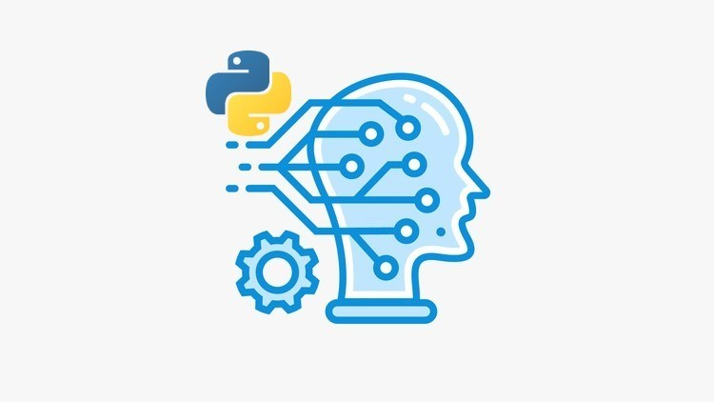
The Machine Learning Process
Python 101 – Modules and packages
Sathish Ravichandran

Slide 2


What is Module?
Modules are .py script that we call in another .py script
Packages are collection of modules
Since we are going to work with .py scripts we cannot use Jupyter notebook. Instead, we will be using Sublime text editor

Slide 3
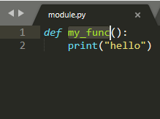
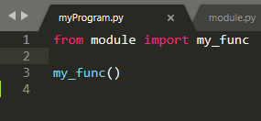
Let’s create module
Open Sublime text and create the following files in the same location:
  module.py myProgram.py
Notes:
#module.py
def my_func():
print("hello world")
#myProgram.py
from module import my_func
my_func()

Slide 4

Run
Open cmd and change our current working directory to the location where the files are present
Type the command Python myProgram.py
Notes:
cd <location where your file is present>
Python myProgram.py

Slide 5
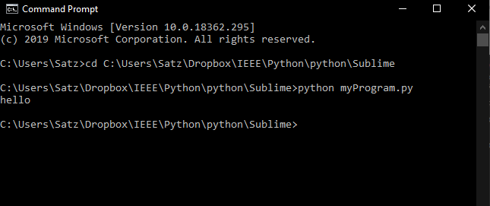
Output
This will not be enough when the project gets bigger

Slide 6
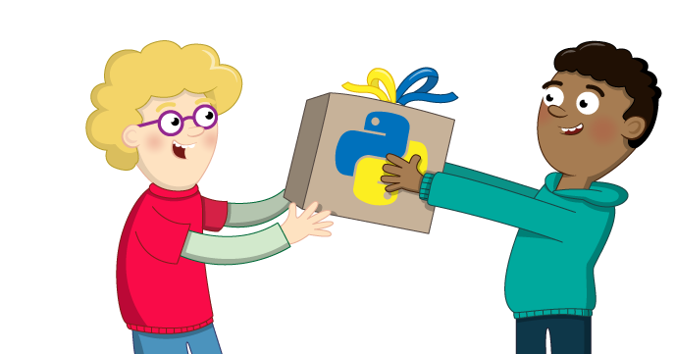
Packages
We need to create packages to make use of folders and subfolders

Slide 7
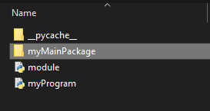

Packages
First create a main folder
Then create a subfolder inside the main folder

Slide 8
Packages
To make python treat a folder not as directories but as a package, we need to create __init__.py in the folder.
Hence,
  Create __init__.py inside MyMainPackage folder
  Create __init__.py inside SubPackage folder

Slide 9
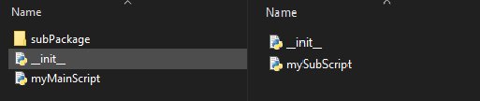
Packages
Now let's create the actual scripts inside MyMainPackage and subPackage
myMainPackage.py subPackage.py

Slide 10
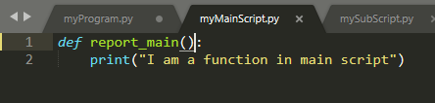

Packages
Write the following scripts in the file
myMainPackage.py
subPackage.py
Notes:
#myMainPackage.py
def report_main():
print("I am a function in main script")
#subPackage.py
def sub_report():
print("I am a function inside mySubScript")

Slide 11
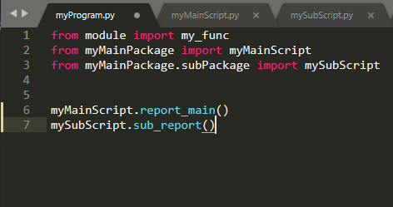
Packages
Import and call the functions from different modules
Notes:
from module import my_func
from myMainPackage import myMainScript
from myMainPackage.subPackage import mySubScript
myMainScript.report_main()
mySubScript.sub_report()

Slide 12
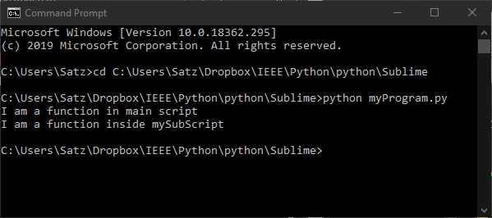
Packages
And now let’s Run the program
Notes:
cd <location where your file is present>
Python myProgram.py

Slide 13

__name__ and __main__
Q: how does python knows where to start the execution in the script?

Slide 14
__name__ and __main__
When we run the script, python assigns __main__ to __name__ variable
If __name__ == “__main__”:
  The above statement will be used to identify if the .py script is executed directly or it is being imported.

Slide 15
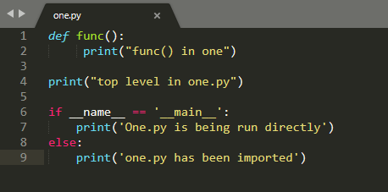
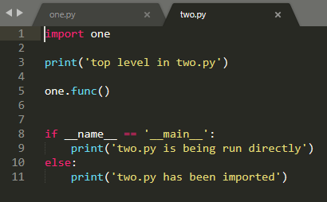
Let’s write some code
What do you think will happen when we run one.py?
What do you think will happen when we run two.py?
Notes:
#one.py
def func():
print("func() in one")
print("top level in one.py")
if __name__ == '__main__':
print('One.py is being run directly')
else:
print('one.py has been imported’)
#two.py
import one
print('top level in two.py')
one.func()
if __name__ == '__main__':
print('two.py is being run directly')
else:
print('two.py has been imported')

Slide 16
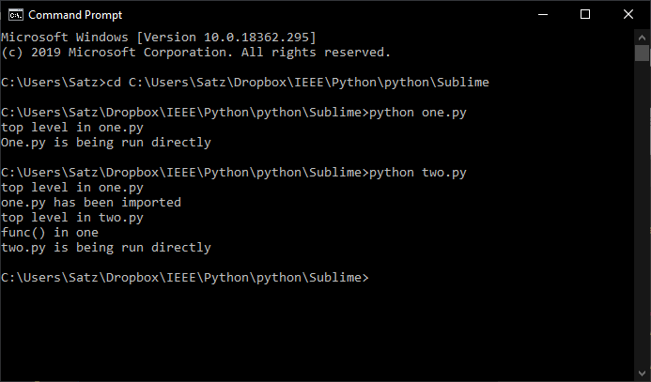
Let’s Analyze
Notes:
python one.py
python two.py

Slide 17
Thank you
The Capacity to learn is a gift;
The ability to learn is a skill;
The willingness to learn is a choice.
-Brian Herbert

